Slide 1
Higher-Order Components in React

Slide 2

Get an insight of higher-order components in react, a design pattern that enhances and facilitates the reuse of component logic
Create React HOC to enhance the code reusability and component abstraction in React applications
Create React HOC with authorization features to showcase its seamless integration into a secured and controlled authentication system
Identify and leverage HOCs to address complex issues in react applications, optimizing code organization, abstracting logic, and resolving problems effectively

Slide 3
Understanding the Concept of Higher-Order Components

Slide 4
Higher-Order Components
HOCs are programming optimization functions for storing and reusing the results of expensive function calls. It is used to optimize the rendering process in the context of React.
Higher-order components
Components
(Returns a component)
(Returns an element)
It lets developers group common logic into reusable functions, empowering them to enhance existing components without altering the core code.
Notes:
Trainer Notes:
If we go by definition, Higher-Order Component is a programming optimization function that takes a component as an argument and returns a new component. This new component, enhanced with the injected logic, can then be used in place of the original component.
It lets developers group common logic into reusable functions, empowering them to enhance existing components without altering the core code.

Slide 5
Higher-Order Components
In programming, higher-order often refers to something that operates on or returns other functions.
Higher-order components
Components
(Returns a component)
(Returns an element)
They go beyond component rendering and instead concentrate on manipulating and extending the behavior of other components.
Notes:
Trainer Notes: The term "Higher Order" refers to the fact that HOCs operate at a higher level of abstraction compared to regular React components. They transcend the boundaries of component rendering and instead focus on manipulating and extending the behavior of other components.
The essence of HOCs lies in their ability to transform components. By taking a component as an argument, a HOC can inject additional logic or behavior into the component, effectively creating a new and enhanced version.

Slide 6
HOC’s Workflow
HOCs are used in React to improve a basic component without modifying its code directly. The below diagram explains the workflow:
Higher-order components
Components
React element
(Returns a component)
(Returns an element)
(Basic building block of react)
Therefore, the HOCs are responsible for rendering the component to the react element.
Notes:
Trainer Notes:
Here is a detailed explanation of the process of using a higher-order component (HOC) in React:
The HOC is called with the Component as an argument.
This is the first step in the process of using an HOC. The HOC takes a component as an argument, and it will use this component to create a new component. The new component will have the same functionality as the original component, but it will also have the additional functionality that is added by the HOC.
The HOC returns a new component that wraps the Component.
The HOC creates a new component that wraps the original component. This means that the new component will render the original component to the DOM. The new component can also add additional functionality to the original component, such as logging to the console or adding a loading indicator.
The new component is rendered to the DOM.
Once the new component has been created, it is rendered to the DOM. This means that the new component's HTML is added to the DOM, and the new component's JavaScript is executed.
The LOC is rendered to the DOM.
The original component, also known as the lower-order component (LOC), is rendered to the DOM by the new component. This means that the LOC's HTML is added to the DOM, and the LOC's JavaScript is executed.
The React element is returned.
The React element that is returned by the HOC is the element that is ultimately rendered to the DOM. This element is created by the LOC.

Slide 7
Creating a React HOC
Duration: 20 min
Problem Statement:​
​
You have been assigned the task to create a React HOC.

Slide 8
Assisted Practice: Guidelines
Steps to be followed:
Create and set up the ReactJS project
Create one user-defined component to demonstrate without the HOC concept
Create HOC and more than one user-defined component that passes the parameter to HOC components
Import all components in the App.js file
Test the application

Slide 9
Use Cases for Higher-Order Components

Slide 10
Use Cases
Higher-order components
Authentication and authorization
Data fetching and caching
Event handling and subscription management
Styling and theme management
Accessibility enhancements
Notes:
Trainer Notes:
HOCs shine in a variety of scenarios where common logic and behavior need to be reused across multiple components. Here are some compelling use cases:
Authentication and Authorization: HOCs can handle user authentication and authorization checks, ensuring that only authorized users can access specific components.
Data Fetching and Caching: HOCs can abstract data fetching and caching logic, simplifying data access for multiple components.
Event Handling and Subscription Management: HOCs can centralize event handling and subscription management, reducing boilerplate code and promoting maintainability.
Styling and Theme Management: HOCs can encapsulate styling and theme-related logic, ensuring consistent styling across components.
Accessibility Enhancements: HOCs can incorporate accessibility best practices, ensuring that components are accessible to users with disabilities.

Slide 11
Creating a React HOC to Handle Asynchronous Data
Duration: 20 min
Problem Statement:​
​
You have been assigned the task to create a React HOC to handle asynchronous data.

Slide 12
Assisted Practice: Guidelines
Steps to be followed:
Create and set up the ReactJS project
Create user-defined functions and components
Import components in the App.js file
Run the application

Slide 13
Leveraging HOCs for Authentication, Routing, and Data Fetching in React

Slide 14

Authentication with HOCs
HOCs play an important role in streamlining and simplifying authentication processes in React applications. They offer multiple ways to achie­ve this goal:
Consistent authentication behavior
Modular approach
Encapsulation of authentication logic
Notes:
Trainer Notes:
HOCs can be used to simplify and streamline authentication processes in React applications in several ways:
Modular approach: HOCs allow you to encapsulate authentication logic into a single component, making it easier to manage and reuse throughout the application. This reduces code duplication and improves maintainability.
Encapsulation of authentication logic: HOCs separate authentication logic from component logic, making it easier to modify and update authentication mechanisms without affecting other parts of the application. This modularity simplifies code management and reduces the risk of introducing bugs.
Consistent authentication behavior: HOCs enforce consistent authentication behavior across the application by applying the same authentication rules for all protected components. This ensures that unauthorized users cannot access sensitive data or perform restricted actions, maintaining the integrity of the application's security measures.

Slide 15
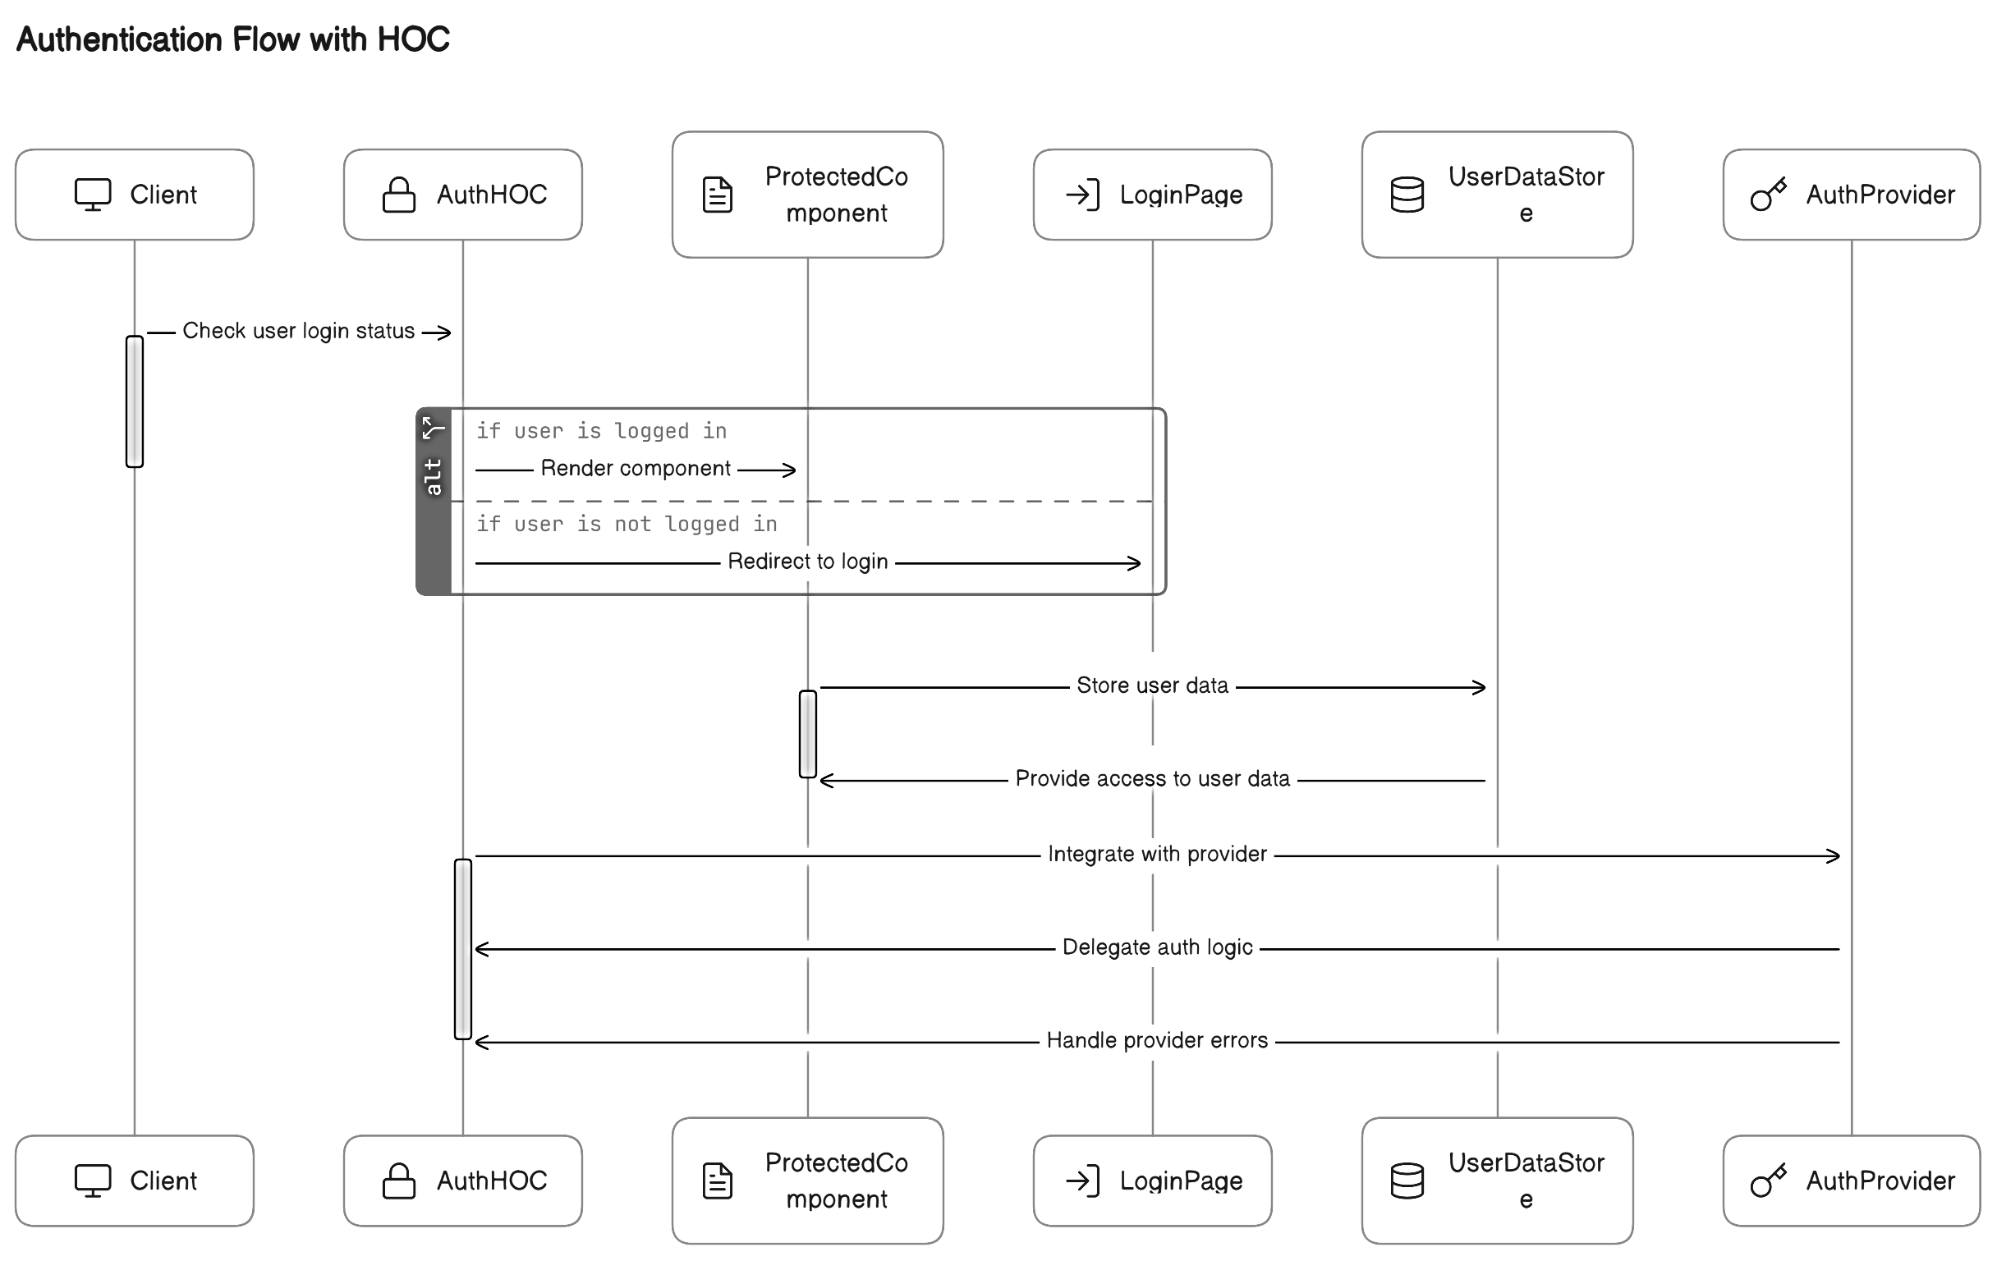
Implementing Authentication with HOCs
In React, creating a reusable HOC for authentication logic is essential. This HOC ensures only authorize­d users can access protecte­d components.
Authentication flow with HOC
Notes:
Trainer Notes:
Implementing authentication with higher-order components (HOCs) in React involves creating a reusable HOC that handles authentication logic and wrapping protected components with this HOC to ensure only authorized users can access them.
Step 1: Create an Authentication HOC
Define the HOC Function: Create a function that takes a component as an argument and returns a new component that encapsulates the authentication logic.
Check User Login Status: Implement logic within the HOC to check if the user is currently logged in. This might involve checking local storage, session storage, or a user authentication token.
Handle Unauthenticated Users: If the user is not logged in, redirect them to the login page or display an appropriate message, preventing them from accessing protected components.
Render Protected Component: If the user is logged in, render the wrapped component, allowing them to access the protected content.
Step 2: Wrap Protected Components
Identify Protected Components: Identify components that require user authentication to access. These components typically contain sensitive data or perform actions that should only be available to logged-in users.
Wrap Protected Components with HOC: Use the Authentication HOC to wrap each protected component. This will ensure that the HOC's authentication logic applies to the wrapped component.
Step 3: Manage User Data
Store User Data: Implement a mechanism to store user data securely, such as using local storage or session storage. This data could include user ID, username, email, and any other relevant user information.
Provide Access to User Data: Within the Authentication HOC or protected components, provide access to the stored user data. This allows the application to personalize the user experience or perform actions based on the user's permissions.
Step 4: Integrate with Authentication Provider
Choose Authentication Provider: If using an authentication provider like Firebase or Auth0, integrate the HOC with the provider's authentication methods. This allows the HOC to handle user login, logout, and token management.
Delegate Authentication Logic: Delegate authentication-specific tasks to the authentication provider. This might involve using the provider's SDK to handle user authentication, token retrieval, and user data management.
Handle Provider Errors: Implement error handling to gracefully handle any errors that arise from the authentication provider.
By following these steps, you can effectively implement authentication with HOCs in React, ensuring that only authorized users can access protected components and sensitive data. This approach promotes code reusability, maintainability, and consistency across your application.

Slide 16
Creating a React HOC Authorization Component
Duration: 20 min
Problem Statement:​
​
You have been assigned the task to create a React HOC with authorization features to showcase its seamless integration into a secured and controlled authentication system.

Slide 17
Assisted Practice: Guidelines
Steps to be followed:
Create and set up the ReactJS project
Create user-defined components and import them into the App.js file
Test the application

Slide 18

Routing with HOCs
It refers to the practice of supervising and improvising the functionality of navigation and route management compone­nts. HOCs can help with routing in the following ways:
Compositionality
Encapsulating routing logic
Reusability
Notes:
Trainer Notes:
Higher-order components (HOCs) can be a valuable for routing in React applications. They offer a modular and reusable approach to adding routing functionality to components, promoting code organization and maintainability.
Here's how HOCs can help with routing:
1. Encapsulating Routing Logic:
HOCs can encapsulate routing logic into dedicated components, separating it from the core logic of your application components. This makes the code cleaner and easier to maintain, as routing concerns are handled in a separate location.
2. Reusability:
HOCs promote code reuse by allowing you to create reusable components for common routing functionalities like authentication checks, redirecting based on user roles, or handling loading states. This reduces code duplication and improves overall efficiency.
3. Compositionality:
HOCs can be composed together to create more complex routing behaviors. You can chain multiple HOCs to apply various routing functionalities to a single component, making it adaptable to various scenarios.

Slide 19
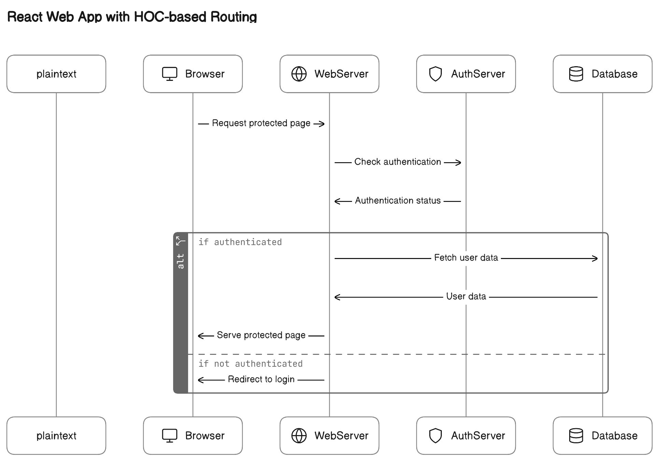
Implementing Routing with HOCs
The­ implementation revolves around le­veraging HOCs to elevate­ the functionality of components linked to navigation and route­ management.
React web application with HOC-based routing
Notes:
Trainer Notes:
Implementing Routing with HOCs in React
While HOCs for routing are not the recommended approach in modern React development due to the availability of dedicated libraries and hooks, they can still be a useful tool to understand. Here's how you can implement routing with HOCs:
1. Create the HOC:
Define a function that takes a component as an argument and returns a new component with routing functionality. This function should:
Access routing information: Use libraries like react-router-dom to access routing information like the current path, history, and match.
Perform routing logic: Implement your desired routing logic, such as checking user authentication, redirecting based on user roles, or displaying loading states.
Render the component: Based on the routing logic, render the intended component or handle other routing behavior like redirects.
This HOC checks user authentication and redirects to the login page if the user is not logged in. It then renders the wrapped component if the user is logged in and the route path matches.
2. Wrap your components:
Use the HOC to wrap the components that require routing functionality. This allows you to add routing logic to specific components without modifying their core functionality.
3. Handle routing logic within the HOC:
You can further enhance your routing HOC to handle various routing scenarios like:
Checking user roles: Redirect to different components based on the user's role.
Displaying loading states: Show a loading indicator while fetching data before rendering the component.
Error handling: Handle routing errors gracefully and display informative messages.
Remember:
While HOCs can be useful for routing, modern React development favors using dedicated libraries like React Router and React Hooks for their more comprehensive and efficient approach.
HOCs for routing can add complexity to your code and require careful management.
Consider alternative solutions before implementing HOCs for routing in your projects.

Slide 20

Data Fetching with HOCs
In React, it refers to the process of acquiring data from external sources, like APIs or servers, and then using it to populate your application's user interface.
HOC encapsulates data fetching logic, including API requests, loading states, and data storage. It wraps a component, adding data and functionality. The wrapped component then receives and renders data as props.
Notes:
Trainer Notes:
Data Fetching with Higher-Order Components (HOCs)
In React, data fetching refers to the process of acquiring data from external sources, like APIs or servers, and then using that data to populate your application's user interface. It's a crucial aspect of most dynamic React applications as it allows you to present rich and up-to-date information to your users.
Higher-Order Components (HOCs) are a powerful pattern in React for sharing logic between components. They take a component as input and return a new component that wraps the original, adding additional functionalities.
Benefits of using HOCs for data fetching:
Clean and organized code: Separates data fetching logic from UI components.
Code reusability: Share data fetching logic across different components.
Improved testability: Easier to test data fetching logic in isolation.
HOC encapsulates data fetching logic, including API requests, loading states, and data storage. It wraps a component, adding data and functionality. The wrapped component then receives and renders data as props.

Slide 21
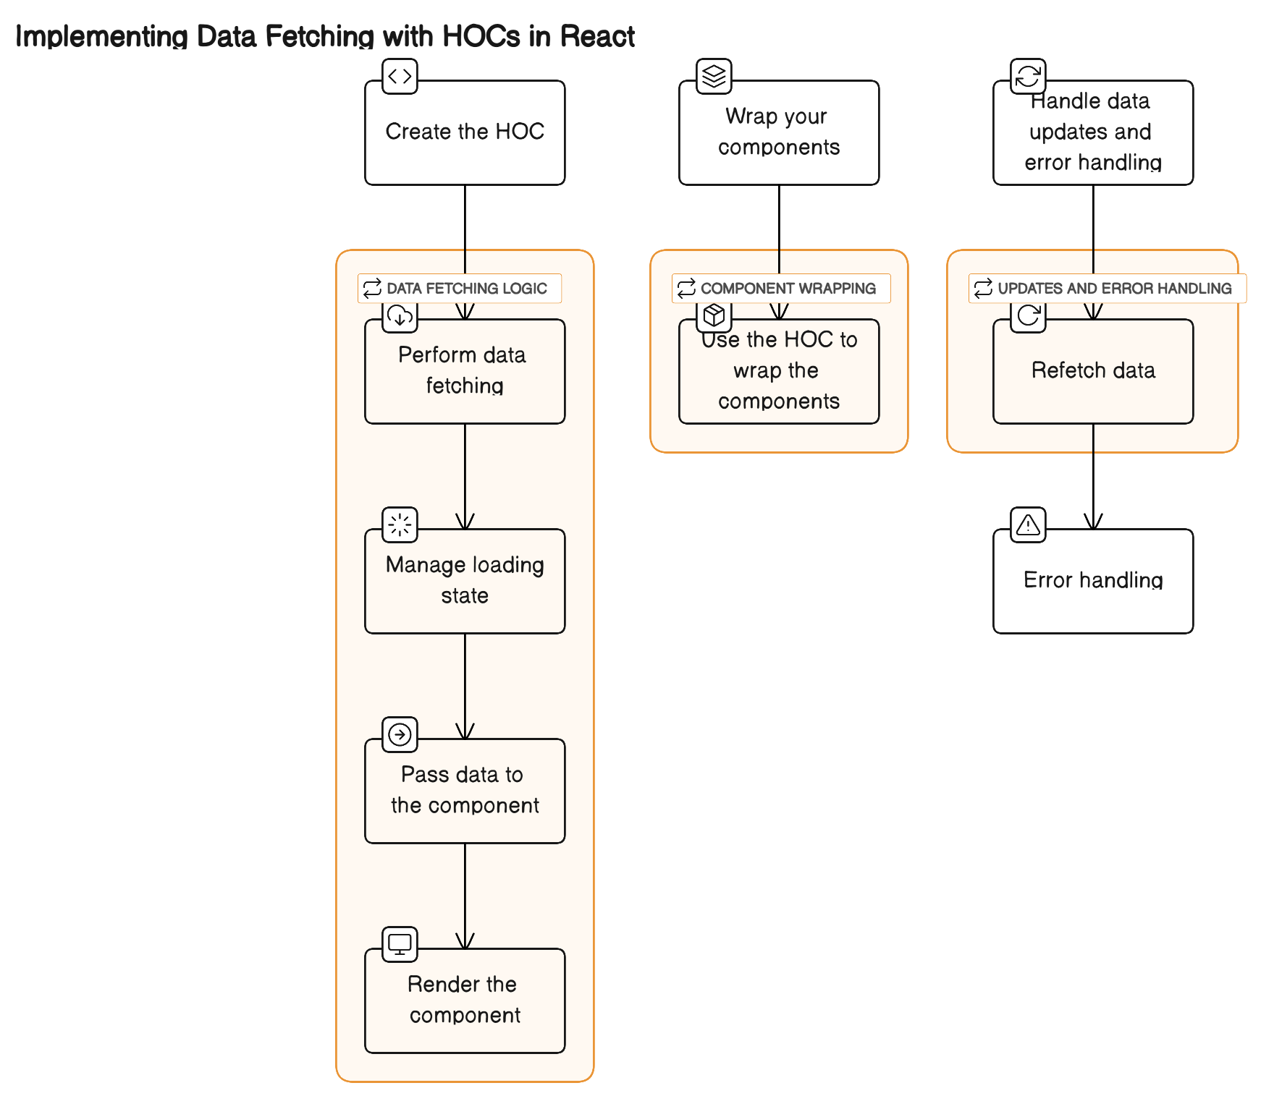
Implementing Data Fetching with HOCs in React
Notes:
Trainer Notes:
Implementing Data Fetching with HOCs in React
Here's how HOCs can be used for data fetching:
1. Create the HOC:
Define a function that takes a component and data fetching logic as arguments. This function should:
Perform data fetching: Use libraries like axios or built-in fetch API to fetch data from an API or other source.
Manage loading state: Show a loading indicator while the data is being fetched.
Pass data to the component: Provide the fetched data as props to the wrapped component.
Render the component: Render the wrapped component with the fetched data.
2. Wrap your components:
Use the HOC to wrap the components that require data to be fetched. This allows you to separate data fetching logic from the component's presentation layer.
3. Handle data updates and error handling:
Your HOC can also handle updates and errors:
Refetch data: Implement logic to refetch data when specific events occur, like user interaction.
Error handling: Display error messages and handle network issues gracefully.

Slide 22
Advanced HOC Techniques
There are­ advanced techniques that offe­r more possibilities and can overcome­ limitations. Some of them are as follows:
Composition
Generic HOCs
Conditional HOCs
Hooks with HOCs
Hoisting
Dependency injection
Higher-order renderers
Error handling
Static HOCs
Code splitting
Notes:
Trainer Notes:
Advanced HOC Techniques
While basic HOCs are a powerful tool for code reuse and data fetching, advanced techniques can further enhance their functionality and address some of their limitations. Here are some advanced HOC techniques:
1. Composition: Combine multiple HOCs to achieve complex functionality. Each HOC can handle a specific task, and their combined effect creates a more powerful component.
2. Conditional HOCs: Use conditional logic to apply HOCs only to specific components or based on certain conditions. This helps to avoid unnecessary overhead and maintain code clarity.
3. Hoisting: Extract shared logic from multiple HOCs into a separate function to reduce code duplication and improve maintainability.
4. Higher-Order Renderers: Instead of returning a new component, the HOC can return a render function that receives props and returns the component to render. This offers more flexibility in handling different scenarios.
5. Static HOCs: Use static methods in the HOC to pre-compute data or define static properties to improve performance and code clarity.
6. Generic HOCs: Create generic HOCs that can accept any component as input and add specific functionalities. This promotes code reusability across diverse components.
7. Hooks with HOCs: Combine HOCs with React hooks like useState and useEffect for more granular control over data fetching and component lifecycle.
8. Dependency Injection: Inject dependencies into HOCs using libraries like react-di to improve modularity and testability.
9. Error Handling: Implement robust error handling within HOCs to gracefully handle API failures and network errors.
10. Code Splitting: Utilize code splitting techniques with HOCs to improve performance and reduce initial bundle size, especially for large applications.
Benefits of Advanced HOC Techniques:
Increased code reusability and maintainability
Improved performance and efficiency
More flexible and dynamic component behavior
Enhanced testability and error handling
Challenges of Advanced HOC Techniques:
Increased complexity and potential for nesting
Debugging can be more challenging
May not be necessary for every situation
Conclusion:
Advanced HOC techniques offer powerful tools for building complex and robust React applications. However, it's crucial to understand the trade-offs and use them judiciously to avoid making your code overly complex.

Slide 23

Solve Complex Problems with HOCs
There are some ways to solve complex problems with HOCs, such as:
Styling and CSS-in-JS
Prop manipulation
Data fetching and state management
Conditional rendering
Notes:
Trainer Notes:
Complex problems in React generally refer to challenges or difficulties that developers may face when working on more intricate or sophisticated aspects of a React application. These challenges can arise due to the nature of building large-scale or feature-rich applications. Here are some common examples of complex problems in React:
Prop Drilling:
Passing data through multiple layers of components can become cumbersome, leading to prop drilling. This can make the code harder to maintain and understand.
State Management:
As applications grow, managing state across various components becomes more complex. Ensuring that the application state is predictable and consistent can be challenging.
Global State Management:
Coordinating and managing global state that needs to be shared across different parts of the application can become complex without proper tools or patterns.
Performance Optimization:
Optimizing the performance of React applications, especially when dealing with large datasets or complex UIs, can be challenging. Minimizing unnecessary renders and ensuring smooth interactions are crucial.
Conditional Rendering:
Implementing conditional rendering based on dynamic factors like user authentication, data availability, or other runtime conditions can introduce complexity.
Integration with External Libraries:
Integrating React with external libraries or frameworks, especially those not designed with React in mind, may require overcoming compatibility issues and ensuring smooth data flow.
Forms and User Input:
Handling complex forms with validation, conditional rendering based on user input, and managing form state can be challenging.
Cross-Component Communication:
Establishing effective communication between components that are not direct siblings in the component tree can be complex, requiring careful design to avoid tightly coupled components.
Dealing with these complexities often involves applying advanced React concepts, utilizing state management libraries, and adopting best practices to maintain code readability, scalability, and performance.
Here are some ways to solve complex problems with HOCs:
Prop Manipulation:
Conditional Rendering:
Data Fetching and State Management:
Styling and CSS-in-JS:

Slide 24

Prop Manipulation
It refers to the process of dynamically modifying or controlling the properties passed to a React component. Below are the steps on how to use HOCs for prop manipulation:
Step 1
Identify the prop manipulation challenge
Step 2
Create a prop manipulation HOC
Step 3
Implement prop logic in the HOC
Step 4
Handle edge cases
Step 5
Testing
Step 6
Documentation
Notes:
Trainer Notes:
Prop manipulation refers to the process of dynamically modifying or controlling the props (properties) passed to a React component.
Prop manipulation can be a tricky task whe­n working with React applications. It often involves finding cle­ver solutions to enhance or modify compone­nt props. One powerful tool for tackling this challenge­ is Higher-Order Components (HOCs). The­se offer a robust mechanism for handling prop manipulation.
Here's a guide on how to use HOCs for prop manipulation:
Identify the Prop Manipulation Challenge:
Clearly define the prop manipulation challenge you're aiming to solve. This could involve adding default values, transforming props, or conditionally modifying them.
Create a Prop Manipulation HOC:
Develop a new HOC or choose an existing one to serve as the foundation for prop manipulation.
Ensure the HOC is flexible and can accept parameters to customize its behavior based on specific prop manipulation needs.
Implement Prop Logic in the HOC:
Inside the HOC, implement the logic for prop manipulation. This could involve checking existing prop values, adding defaults, transforming data, or conditionally modifying props based on certain conditions.
Handle Edge Cases:
Anticipate and handle edge cases that may arise from prop manipulation.
Ensure the HOC gracefully manages various scenarios to prevent unexpected behavior when dealing with different types of props.
Testing:
Write thorough unit tests for the prop manipulation HOC.
Cover different use cases, including edge cases, to validate that the HOC behaves as expected in various scenarios.
Documentation:
Clearly document the purpose and usage of the prop manipulation HOC.
Provide examples and guidance on how developers should use the HOC for effective prop manipulation.
Apply the HOC:
Apply the prop manipulation HOC to the components where the challenge exists.
Leverage the reusability of the HOC to implement consistent prop manipulation across multiple components.
Iterate and Refine:
Gather feedback from testing and real-world usage.
Iterate on the HOC implementation based on feedback, making improvements and adjustments as necessary.
Optimize for Reusability:
Ensure that the prop manipulation HOC is designed for reusability across different components and use cases.
Explore ways to make the HOC customizable to handle various types of props and scenarios.
Share Knowledge:
Share insights and best practices related to prop manipulation with the development team.
Encourage collaboration and knowledge-sharing to enhance the understanding and usage of the prop manipulation HOC.
Monitor and Maintain:
Monitor the usage and performance of the prop manipulation HOC in the application.
Maintain the HOC by updating it as needed to accommodate changes in the application or React itself.
By following these steps, you can effectively use HOCs to address prop manipulation challenges in your React application, promoting code reusability and maintainability.
Prop Manipulation:
HOCs can be used to manipulate props that are passed down to wrapped components. This can be useful for tasks such as:
Adding default props to components that may not always receive them
Validating or transforming props before they are passed to a component
Managing prop forwarding to ensure consistent behavior
For example, you could create a HOC that adds a default loading prop to components that fetch data. This would ensure that the component always renders a loading indicator while the data is being fetched, even if the prop is not explicitly passed down.

Slide 25
Prop Manipulation
It refers to the process of dynamically modifying or controlling the properties passed to a React component. Below are the steps on how to use HOCs for prop manipulation:
Step 7
Apply the prop manipulation HOC
Step 8
Iterate and refine
Step 9
Optimize for reusability
Step 10
Share knowledge
Step 11
Monitor and maintain
Notes:
Trainer Notes:
Prop manipulation can be a tricky task whe­n working with React applications. It often involves finding cle­ver solutions to enhance or modify compone­nt props. One powerful tool for tackling this challenge­ is Higher-Order Components (HOCs). The­se offer a robust mechanism for handling prop manipulation.
Here's a guide on how to use HOCs for prop manipulation:
Identify the Prop Manipulation Challenge:
Clearly define the prop manipulation challenge you're aiming to solve. This could involve adding default values, transforming props, or conditionally modifying them.
Create a Prop Manipulation HOC:
Develop a new HOC or choose an existing one to serve as the foundation for prop manipulation.
Ensure the HOC is flexible and can accept parameters to customize its behavior based on specific prop manipulation needs.
Implement Prop Logic in the HOC:
Inside the HOC, implement the logic for prop manipulation. This could involve checking existing prop values, adding defaults, transforming data, or conditionally modifying props based on certain conditions.
Handle Edge Cases:
Anticipate and handle edge cases that may arise from prop manipulation.
Ensure the HOC gracefully manages various scenarios to prevent unexpected behavior when dealing with different types of props.
Testing:
Write thorough unit tests for the prop manipulation HOC.
Cover different use cases, including edge cases, to validate that the HOC behaves as expected in various scenarios.
Documentation:
Clearly document the purpose and usage of the prop manipulation HOC.
Provide examples and guidance on how developers should use the HOC for effective prop manipulation.
Apply the HOC:
Apply the prop manipulation HOC to the components where the challenge exists.
Leverage the reusability of the HOC to implement consistent prop manipulation across multiple components.
Iterate and Refine:
Gather feedback from testing and real-world usage.
Iterate on the HOC implementation based on feedback, making improvements and adjustments as necessary.
Optimize for Reusability:
Ensure that the prop manipulation HOC is designed for reusability across different components and use cases.
Explore ways to make the HOC customizable to handle various types of props and scenarios.
Share Knowledge:
Share insights and best practices related to prop manipulation with the development team.
Encourage collaboration and knowledge-sharing to enhance the understanding and usage of the prop manipulation HOC.
Monitor and Maintain:
Monitor the usage and performance of the prop manipulation HOC in the application.
Maintain the HOC by updating it as needed to accommodate changes in the application or React itself.
By following these steps, you can effectively use HOCs to address prop manipulation challenges in your React application, promoting code reusability and maintainability.

Slide 26

Conditional Rendering
This technique creates a function to decide if the wrapped component should be rendered under specific conditions. Below are the steps on how to use HOCs for conditional rendering:
Step 1
Identify the conditional rendering challenge
Step 2
Create a conditional rendering HOC
Step 3
Implement conditional rendering logic in the HOC
Step 4
Handle edge cases
Step 5
Testing
Step 6
Documentation
Notes:
Trainer Notes:
Conditional rendering is a common challenge in React applications, often requiring dynamic decision-making about whether to render a component based on certain conditions. Higher-Order Components (HOCs) can be a powerful solution to address conditional rendering challenges. Here's a guide on how to use HOCs for conditional rendering:
Identify the Conditional Rendering Challenge:
Clearly define the conditional rendering challenge you're aiming to solve. This could involve rendering a component based on user authentication, data availability, or other runtime conditions.
Create a Conditional Rendering HOC:
Develop a new HOC or choose an existing one to serve as the foundation for conditional rendering.
Ensure the HOC is flexible and can accept parameters to customize its behavior based on specific conditional rendering needs.
Implement Conditional Rendering Logic in the HOC:
Inside the HOC, implement the logic for conditional rendering. This could involve evaluating props, state, or external factors to determine whether the wrapped component should be rendered.
Handle Edge Cases:
Anticipate and handle edge cases that may arise from conditional rendering.
Ensure the HOC gracefully manages various scenarios to prevent unexpected behavior when dealing with different conditions.
Testing:
Write thorough unit tests for the conditional rendering HOC.
Cover different use cases, including edge cases, to validate that the HOC behaves as expected in various scenarios.
Documentation:
Clearly document the purpose and usage of the conditional rendering HOC.
Provide examples and guidance on how developers should use the HOC for effective conditional rendering.
Apply the HOC:
Apply the conditional rendering HOC to the components where the challenge exists.
Leverage the reusability of the HOC to implement consistent conditional rendering across multiple components.
Iterate and Refine:
Gather feedback from testing and real-world usage.
Iterate on the HOC implementation based on feedback, making improvements and adjustments as necessary.
Optimize for Reusability:
Ensure that the conditional rendering HOC is designed for reusability across different components and use cases.
Explore ways to make the HOC customizable to handle various types of conditions.
Share Knowledge:
Share insights and best practices related to conditional rendering with the development team.
Encourage collaboration and knowledge-sharing to enhance the understanding and usage of the conditional rendering HOC.
Monitor and Maintain:
Monitor the usage and performance of the conditional rendering HOC in the application.
Maintain the HOC by updating it as needed to accommodate changes in the application or React itself.
By following these steps, you can effectively use HOCs to address conditional rendering challenges in your React application, promoting code reusability and maintainability.

Slide 27
Conditional Rendering
This technique creates a function to decide if the wrapped component should be rendered under specific conditions. Below are the steps on how to use HOCs for conditional rendering:
Step 7
Apply the HOC
Step 8
Iterate and refine
Step 9
Optimize for reusability
Step 10
Share knowledge
Step 11
Monitor and maintain
Notes:
Trainer Notes:
Conditional rendering is a common challenge in React applications, often requiring dynamic decision-making about whether to render a component based on certain conditions. Higher-Order Components (HOCs) can be a powerful solution to address conditional rendering challenges. Here's a guide on how to use HOCs for conditional rendering:
Identify the Conditional Rendering Challenge:
Clearly define the conditional rendering challenge you're aiming to solve. This could involve rendering a component based on user authentication, data availability, or other runtime conditions.
Create a Conditional Rendering HOC:
Develop a new HOC or choose an existing one to serve as the foundation for conditional rendering.
Ensure the HOC is flexible and can accept parameters to customize its behavior based on specific conditional rendering needs.
Implement Conditional Rendering Logic in the HOC:
Inside the HOC, implement the logic for conditional rendering. This could involve evaluating props, state, or external factors to determine whether the wrapped component should be rendered.
Handle Edge Cases:
Anticipate and handle edge cases that may arise from conditional rendering.
Ensure the HOC gracefully manages various scenarios to prevent unexpected behavior when dealing with different conditions.
Testing:
Write thorough unit tests for the conditional rendering HOC.
Cover different use cases, including edge cases, to validate that the HOC behaves as expected in various scenarios.
Documentation:
Clearly document the purpose and usage of the conditional rendering HOC.
Provide examples and guidance on how developers should use the HOC for effective conditional rendering.
Apply the HOC:
Apply the conditional rendering HOC to the components where the challenge exists.
Leverage the reusability of the HOC to implement consistent conditional rendering across multiple components.
Iterate and Refine:
Gather feedback from testing and real-world usage.
Iterate on the HOC implementation based on feedback, making improvements and adjustments as necessary.
Optimize for Reusability:
Ensure that the conditional rendering HOC is designed for reusability across different components and use cases.
Explore ways to make the HOC customizable to handle various types of conditions.
Share Knowledge:
Share insights and best practices related to conditional rendering with the development team.
Encourage collaboration and knowledge-sharing to enhance the understanding and usage of the conditional rendering HOC.
Monitor and Maintain:
Monitor the usage and performance of the conditional rendering HOC in the application.
Maintain the HOC by updating it as needed to accommodate changes in the application or React itself.
By following these steps, you can effectively use HOCs to address conditional rendering challenges in your React application, promoting code reusability and maintainability.
HOCs can also be used to conditionally render components based on certain conditions. This can be useful for tasks such as:
Showing or hiding components based on user input or data
Implementing conditional visibility based on component state
Creating dynamic routing without modifying components
For instance, you could create a HOC that conditionally renders a component based on whether a user is logged in. This would allow you to display different content depending on the user's authentication status without modifying the actual components that render the content.

Slide 28

Data Fetching and State Management
HOCs simplify data fetching and state management by encapsulating reusable logic. Below are the steps on how to use HOCs for these steps:
Step 1
Identify the data fetching challenge
Step 2
Create a data fetching HOC
Step 3
Implement data fetching logic in the HOC
Step 4
Access data in the wrapped component
Notes:
Trainer Notes:
Implementing data fetching and state management in React applications often involves handling asynchronous operations and managing the state of the fetched data. Higher-Order Components (HOCs) can be a powerful tool to encapsulate this logic and make it reusable across different components. Here's a guide on how to use HOCs for data fetching and state management:
1Data Fetching and State Management with HOC
Define Data Fetching Requirements:
Identify components that require data fetching, loading state management, and error handling.
Create a Data Fetching HOC:
Develop a HOC that encapsulates the logic for fetching data, managing loading states, and handling errors.
Apply the Data Fetching HOC:
Apply the Data Fetching HOC to components that need data. Pass the API URL as a parameter.
Access Data in wrapped component:
In the wrapped component (MyComponent), access the data, loading state, and error as props. Use this data to conditionally render the UI.
By following these steps, you can use the Data Fetching HOC to efficiently manage data fetching, loading states, and errors across multiple components in your React application.

Slide 29

Styling and CSS-in-JS
In React applications, styling is an important aspe­ct that requires careful manage­ment. It should be modular, easily maintainable­, and limited to specific components. Below are the steps on how to use HOCs for styling:
Step 1
Identify the styling challenge
Step 2
Choose a CSS-in-JS library
Step 3
Create a styling HOC
Step 4
Implement styling logic in the HOC
Step 5
Handle edge cases
Step 6
Testing
Notes:
Trainer Notes:
Styling in React applications often involves managing styles in a way that is modular, maintainable, and scoped to specific components. CSS-in-JS libraries provide a solution to this by allowing you to write styles directly in your JavaScript or TypeScript files. Using Higher-Order Components (HOCs) in combination with CSS-in-JS can enhance the styling capabilities and make them more reusable. Here's a guide on how to leverage HOCs for styling and CSS-in-JS:
1. Identify the Styling Challenge:
Clearly define the styling challenge you're aiming to solve. This could involve scoping styles to specific components, theming, or managing dynamic styles based on props or state.
2. Choose a CSS-in-JS Library:
Select a CSS-in-JS library that aligns with your preferences and project requirements. Popular options include Styled-components, Emotion, and JSS.
3. Create a Styling HOC:
Develop a new HOC or choose an existing one to serve as the foundation for styling with CSS-in-JS.
Ensure the HOC is flexible and can accept parameters to customize its behavior based on specific styling needs.
4. Implement Styling Logic in the HOC:
Inside the HOC, implement the logic for applying styles using the chosen CSS-in-JS library.
Leverage the power of the library to create dynamic and scoped styles.
5. Handle Edge Cases:
Anticipate and handle edge cases related to styling, such as theming, responsive design, or pseudo-classes.
Ensure the HOC gracefully manages various styling scenarios to prevent unexpected behavior.
6. Testing:
Write unit tests for the styling HOC.
Ensure that styles are applied as expected and that the HOC behaves correctly in different use cases.

Slide 30
Styling and CSS-in-JS
In React applications, styling is an important aspe­ct that requires careful manage­ment. It should be modular, easily maintainable­, and limited to specific components. Below are the steps on how to use HOCs for styling:
Step 7
Documentation
Step 8
Apply the HOC
Step 9
Iterate and refine
Step 10
Optimize for reusability
Step 11
Share knowledge
Step 12
Monitor and maintain
Notes:
Trainer Notes:
7. Documentation:
Clearly document the purpose and usage of the styling HOC.
Provide examples and guidance on how developers should use the HOC for effective styling with CSS-in-JS.
8. Apply the HOC:
Apply the styling HOC to the components where the styling challenge exists.
Leverage the reusability of the HOC to implement consistent styling across multiple components.
9. Iterate and Refine:
Gather feedback from testing and real-world usage.
Iterate on the HOC implementation based on feedback, making improvements and adjustments as necessary.
10. Optimize for Reusability:
Ensure that the styling HOC is designed for reusability across different components and use cases.
Explore ways to make the HOC customizable to handle various styling requirements.
11. Share Knowledge:
Share insights and best practices related to styling and CSS-in-JS with the development team.
Encourage collaboration and knowledge-sharing to enhance the understanding and usage of the styling HOC.
12. Monitor and Maintain:
Monitor the usage and performance of the styling HOC in the application.
Maintain the HOC by updating it as needed to accommodate changes in the application or CSS-in-JS library updates.
By following these steps, you can effectively use HOCs to address styling challenges in your React application, especially when combined with CSS-in-JS for a more dynamic and scoped styling approach.
Styling React components can become complex, especially when managing global styles and applying CSS-in-JS techniques. HOCs can provide a structured approach to styling components and encapsulating CSS-in-JS logic.
You can create HOCs that inject custom styles or apply CSS-in-JS classes to wrapped components. This allows you to manage styles more centrally and reuse styling patterns across components.

Slide 31
A higher-order component is a function that takes a component as an argument and returns a new component.
Routing refers to the practice of involving HOCs to supervise and improve the functionality of navigation and route management compone­nts.
Data fetching refers to the process of acquiring data from external sources, like APIs or servers, and then using it to populate your application's user interface.
Prop manipulation refers to the process of dynamically modifying or controlling the properties passed to a React component.

Slide 33
What is the primary purpose of using HOCs in React?
1
To create stateful components
To manage component state
To enhance component functionality and promote reusability
To define component structure

Slide 34
What is the primary purpose of using HOCs in React?
1
To create stateful components
To manage component state
To enhance component functionality and promote reusability
To define component structure
C
HOCs are commonly use­d to improve component functionality by incorporating extra fe­atures or behaviors. They boost re­usability by packaging logic applicable to multiple components.

Slide 35
Which of the following statements about HOCs is true?
2
Can only be used with class components
Can only be used with functional components
Can be used with both class and functional components
Can only be used with Redux

Slide 36
Which of the following statements about HOCs is true?
2
Can only be used with class components
Can only be used with functional components
Can be used with both class and functional components
Can only be used with Redux
C
HOCs can be applied to both class components and functional components in React, providing a flexible way to reuse and enhance component logic.

Slide 37
In React, how does a HOC modify the behavior of a component?
3
By changing the component's HTML structure
By manipulating the component's props
By adding inline styles to the component
By altering the component's state directly

Slide 38
In React, how does a HOC modify the behavior of a component?
3
By changing the component's HTML structure
By manipulating the component's props
By adding inline styles to the component
By altering the component's state directly
B
HOCs can manipulate the props of a component, either by adding new props or modifying existing ones. This allows for dynamic behavior and logic enhancement.

